Slide 1
Functions
Overview
In this lesson, students will learn how to iterate over lists or until a condition has been met.
Duration 120 minutes
Learning Objectives
In this lesson, students will:
Define functions to encapsulate blocks of code.
Use parameters in a function.
Understand how to return a value from a function.
Create functions that include loops and conditional logic to generate specific return values.

Slide 2
Pre-Class Materials and Preparation
For remote classrooms: Virtual breakout rooms and Slack may be needed to facilitate the partner exercise and discussions. As you plan for your lesson:
Consider how you’ll create pairs for the partner exercise (randomly, or with pre-assigned partners).
Determine how (if at all) exercise timing may need to be adjusted.
For helpful tips, keep an eye out for the For remote classrooms tag in the speaker notes.
Prepare screenshots and answers to exercises in advance so that they can be easily shared in Slack during your lecture.

Slide 3
Pre-Class Materials and Preparation (Cont.)
Pre-Work Review: Many of the concepts covered in this class will recap what students learned in the pre-work; in particular, these myGA lessons:
Python Functions
We recommend reviewing the pre-work lessons to understand what students will come to class knowing. Click here to see the study guides for these lessons. You can also view the pre-work materials on myGA.
For review or extension topics, review the notes in the pre-work for recommendations on how to teach the concept. Leverage the discussions, exercises, and knowledge checks to gauge students’ understanding of concepts. You can adjust your approach to the lesson overall based on how students do with these exercises.

Slide 4
Suggested Agenda
Time | Activity
0:00–0:15 | Welcome + Introductions
0:15–0:50 | Python Functions
0:50–1:00 | Break
1:00–1:40 | Problem-Solving Functions
1:40–1:50 | Functions and Lists
1:50–2:00 | Wrapping Up, Q&A, and Exit Ticket Completion

Slide 5
Jupyter Notebook
The exercises referenced in this lesson can be found in the Python Workbooks + Data folder.
Our first few lessons begin by reviewing the notebook, as the same material was covered in the pre-work.
If students feel that they are able to confidently solve the challenges in the workbook, you can quickly skim through the lesson content and have them only complete the challenges.

Slide 6
Functions
Notes:
Duration: 15 minutes

Slide 7
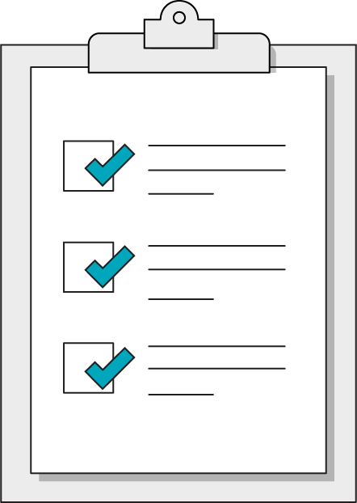
Today’s Learning Objectives
In this lesson, you will:
Define functions to encapsulate blocks of code.
Use parameters in a function.
Understand how to return a value from a function.
Create functions that include loops and conditional logic to generate specific return values.
‹#› | © 2020 General Assembly
Notes:
Purpose: Set expectations for the lesson.
For remote classrooms:
Capture a screenshot of this slide and drop it in the class Slack channel.

Slide 8
What We’ll Practice Today
This class is a blended learning experience. It connects to and reinforces topics that you encountered in the myGA pre-work.
We’re going to return to topics covered in the pre-work and build upon them:
Defining and invoking functions
Writing pseudocode
Notes:
Purpose: Connect the rest of class to what we’ve already learned in the pre-work.
TALKING POINTS:
We know that you encountered some of what’s in today’s lesson in the pre-work. That’s intentional! We use a blended learning approach that incorporates myGA, assessments, and in-class lessons. They all work together to help you succeed in the course and let us know where you’re coming from.
We don’t want to bore you with stuff you already know, but we also don’t want to skip over really crucial topics. We’ll use discussions and exercises to make sure we’re going at your speed when it comes to familiar topics, as well as the new ones.
The pre-work helps you come into the classroom with a solid, foundational understanding of the basics. We’re going to practice and reinforce those topics and then start to build upon them.

Slide 9
Jupyter Notebook Review
10 minutes
Let’s dive right in and use what we learned in the pre-work! We want to understand where you are in your learning journey so that we can give the best possible experience in class.
Look over the exercises in today's Jupyter Notebook and attempt any that seem immediately doable to you.
Then, rate your confidence level on today's subjects from 1–5.
Notes:
Purpose: Understand how much students have retained from the pre-work lessons.
TEACHING TIPS:
This exercise will help you gauge where students are in terms of how much they retained from the pre-work so that you can appropriately adjust the rest of the lesson/future lessons.
Remind students that we're not asking them to complete all questions immediately. Note that, if they are struggling, we’ll recap how to write each of them in this and the following lesson.
For remote classrooms:
Ask students to rate their confidence in this subject using Slack response emojis 1–5, or a quick anonymous poll. If ALL students feel confident in this subject, feel free to skip through the actual lesson slides and dive right into the exercises in the notebook.

Slide 10
Python Functions
Functions
Notes:
Duration: 35 minutes

Slide 11
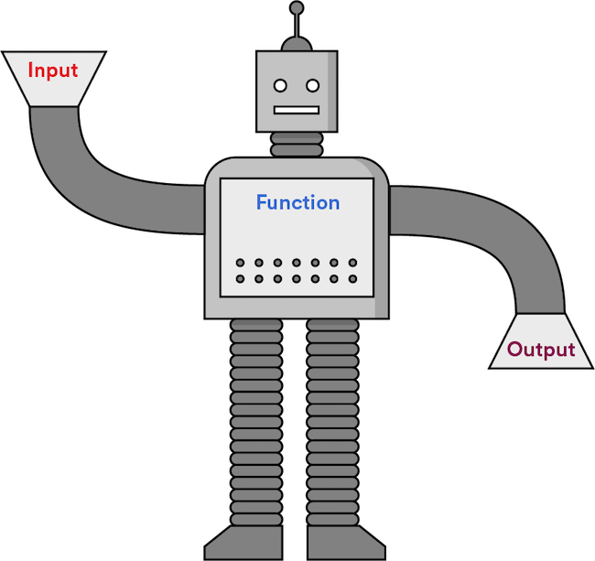
Functions
Functions are chunks of code that are grouped and will execute together, like a modular program within a program.
A function takes input, performs logic, and returns output.
Notes:
Purpose: Review functions.
TALKING POINTS:
Functions allow our programs to start accepting input in meaningful ways. We've already encountered the print() function — now we can start writing our own!
TEACHING TIPS:
This should be a review of what students saw in the pre-work.

Slide 12
Defining Functions
Any name
(snake_case)
Parameter list
(This function does not take parameters.)
def display_greeting(): print('Welcome!')
`def`
required
Colon required
Indentation required
Notes:
Purpose: Review functions.
TEACHING TIPS:
This should be a review of what students saw in the pre-work.
Walk through each part of the function definition by clicking to animate the annotations.

Slide 13
Invoking Functions
Defining a function simply sets things up. For anything to happen, you must invoke the function at some point.
def greetings():
print("hello!")
# Invoke the function using its name and more parentheses.
greetings()
Notes:
Purpose: Remind students of the importance of invoking functions.
TEACHING TIPS:
This should be a review of what students saw in the pre-work.
It's common early on to run code without invoking a function you've defined.
Emphasize the two-step nature of using a function: defining it and then actually invoking it.

Slide 14
Function Parameters and Arguments
get_total_price(100., 0.1)
def get_total_price(list_price, tax_rate): total_price = list_price * (1. + tax_rate)
return total_price
Inside the function body: list_price = 100. tax_rate = 0.1
parameter = argument
Arguments Values passed in to the function
Parameters Variable names within the function
Notes:
Purpose: Review parameters and arguments in functions.
TEACHING TIPS:
This should be a review of what students saw in the pre-work.

Slide 15
Keyword and Positional Arguments
When providing arguments to a function, you can either rely on the position or on keywords to define the specific inputs.
def calculate_area(length, width):
return length * width
calculate_area(8,9)
calculate_area(width=9, length=8)
Notes:
Purpose: Review keyword/positional arguments.

Slide 16
What Does This Function Do?
def mystery_function(list_to_check, value):
for i in range( len(list_to_check) ):
if(list_to_check[i] == value):
return i
return -1
Notes:
Purpose: Have students practice reading and interpreting code.
TEACHING TIPS:
Help students break this down one piece at a time.
This function will return the index location in the given array of the given value, so it’s a search function.
If it doesn't find the value, it will return “-1”.

Slide 17
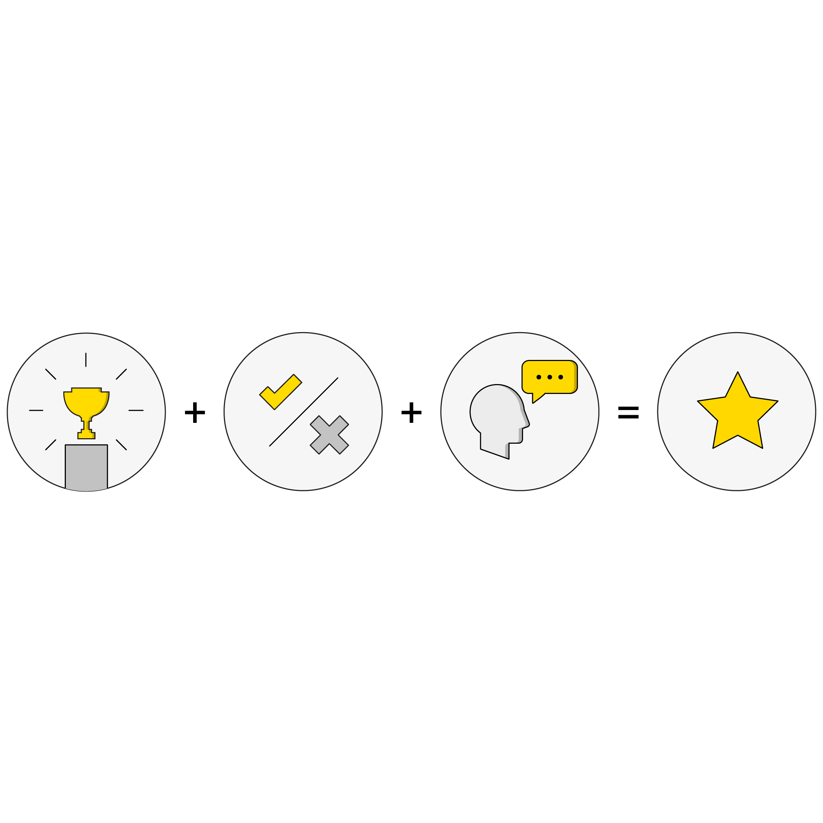
5.1 Functions
30 minutes
Most code challenges you come across will involve writing a function that provides a solution to a given problem.
Section 5.1 has some good initial code challenges to help you practice writing functions.
Notes:
Purpose: Have students practice writing functions.

Slide 18
Pseudocoding
Functions
Notes:
Duration: 40 minutes

Slide 19
The good news about computers is that they do what you tell them to do. The bad news is that they do what you tell them to do.
— Ted Nelson, technology pioneer
Notes:
Purpose: Frame the importance of pseudocode.
TALKING POINTS:
Now that we’ve learned how to write functions, we can consider more complex problems for our programs to tackle.
This will require thinking critically about the individual steps involved in any process we want to represent with a function.

Slide 20
Thinking Like a Computer
The art of programming requires understanding how a computer thinks:
It only knows what you tell it... | ...but it will remember what it’s been told.
It only understands a very limited set of phrases (syntax)... | ...but you can teach it a lot by combining these basic phrases together.
It will always do what you say... | ...but not necessarily what you meant.
It has no understanding of context... | ...but it’s not shy about saying when it doesn’t understand you (error messages).
Notes:
Purpose: Frame the importance of pseudocode.

Slide 21

Using Pseudocode
Pseudocode uses the structure of code without having to worry about the actual coding language (syntax) of the instructions.
Pseudocode is an attempt to break down a larger process into the smallest imaginable component steps.
Notes:
Purpose: Define pseudocode.
TALKING POINTS:
Pseudocode both helps us think like the computer AND creates easily achieved and testable milestones while coding.
Once we have our process defined and broken down into small steps, finding the right syntax and implementation of each step is much easier.

Slide 22
A Stir Fry Program
spices = soy_sauce + rice_vinegar + sugar
oil = 1.5 ounces
brown_rice = 1.5 cups
broccoli = 2 cups
shrimp = .5 pounds
stir_fry():
cook brown_rice
whisk spices
heat oil in pan
add broccoli
cook shrimp
add spices
Notes:
Purpose: Link pseudocode and function writing.
TEACHING TIPS:
Try to talk through this like you would a recipe.
The goal is to normalize the structure of a program, subtly getting students to view the idea of a programming as something they’ve already wrestled with in their lives.
Pause for a second and have students think about how a computer might still misinterpret this. How does it know what cook means for brown_rice? Or whisk?
At some level, we have to define the most basic functions a computer performs, then build up from those basic functions to more sophisticated ones.

Slide 23
A Stir Fry Program With Parameters
The ingredients act as variables being passed into the stir_fry() function.
Recipe verbs are functions you
can use with the ingredient variables.
spices = soy_sauce + rice_vinegar + sugar
oil = 1.5 ounces
brown_rice = 1.5 cups
broccoli = 2 cups
shrimp = .5 pounds
stir_fry(item1, item2, item3, item4, item5):
cook(item1)
whisk(item2, item3)
heat(item3)
combine(item3, item4)
cook(item5)
add(item2)
stir_fry(brown_rice, spices, oil, broccoli, shrimp)
Notes:
Purpose: Link pseudocode and function writing.
TALKING POINTS:
By creating a stir_fry() function and passing it ingredients and ordered steps of additional supporting functions, we’ve created a program that is reusable. This reusability is dependent on passing in a standard input (ingredients in the same order), which then will return a standard output (a consistent meal).

Slide 24
Programs don’t get more complicated because of code. They get more complicated because of the logic behind them.
Notes:
Purpose: Link pseudocode and function writing.
TALKING POINTS:
Using functions is vital to controlling complexity creep. Without smaller functions to package our reusable pieces of logic, our programs might contain hundreds of the tiniest, seemingly unconnected steps spilled out in a row. At the lowest level, any instructions would be absurdly difficult to piece together without larger abstracted bits of logic.

Slide 25
Pseudocoding a Process
5 minutes
Think about a process that you’re required to perform in your role. How you would pseudocode instructions for a new employee?
What inputs are required to perform the process?
What are the concrete steps involved?
What is the output of that process, if any?
Notes:
Purpose: Have students practice writing pseudocode.
TEACHING TIPS:
Complete this activity as a group using one or two examples suggested by the class. You can write the steps down to keep track of them as you go.

Slide 26
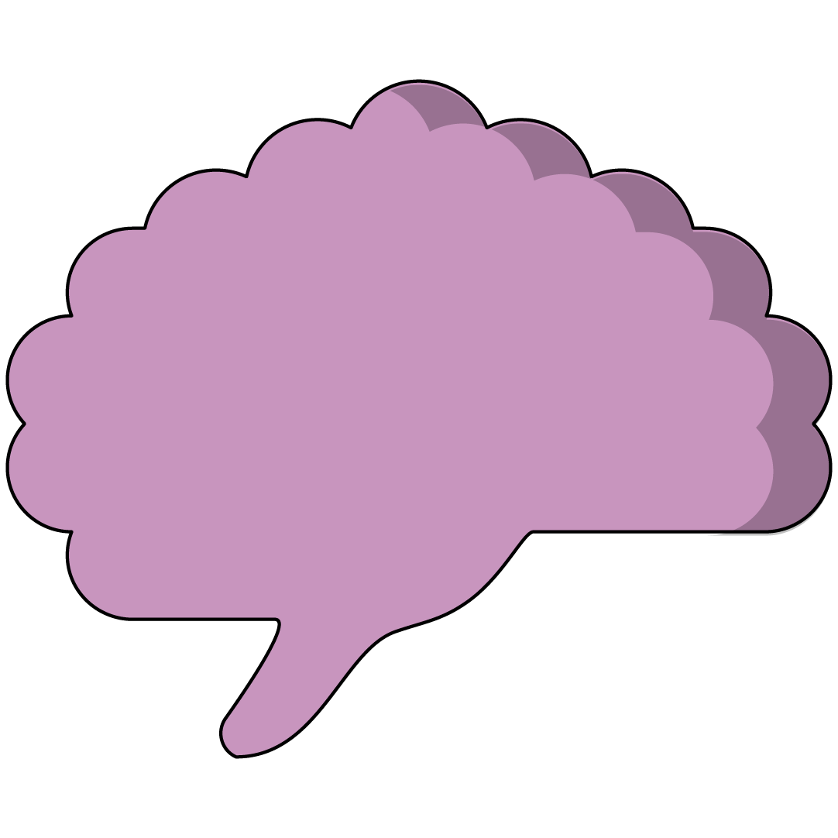
5.2 Problem-Solving Functions
30 minutes
The next few functions will require a bit of problem-solving logic to produce a specific result from given inputs.
Pseudocoding may help you by writing out the steps before coding them!
Notes:
Purpose: Have students practice writing pseudocode in order to solve coding problems.
TALKING POINTS:
Figuring out the steps is the hard part; writing the actual code behind the function is much easier once the steps have been determined.

Slide 27
Functions + Lists
Functions
Notes:
Duration: 10 minutes

Slide 28
Using map()
It’s common to want to apply a function to everything in a list. It’s actually so common that there’s a method to do exactly that: map()!
greetings = ["hi", "hello", "salutations"]
def excitement(word)
return upper(word) + "!!!"
excited_greetings = map(excitement, greetings)
# excited_greetings is ["HI!!!", "HELLO!!!", "SALUTATIONS!!!"]
Notes:
Purpose: Introduce map().

Slide 29
Lambda Functions
In this and in similar situations, you sometimes don’t even want to create a separate function to pass in. You can define a lambda function directly in-line by using the lambda keyword and shortened definition syntax:
greetings = ["hi", "hello", "salutations"]
excited_greetings = map(lambda word : upper(word) + "!!!", greetings)
# excited_greetings is ["HI!!!", "HELLO!!!", "SALUTATIONS!!!"]
Notes:
Purpose: Introduce lambda functions.

Slide 30
Wrapping Up
Functions
Notes:
Duration: 10 minutes

Slide 31
Recap
Looking Ahead
In today’s class, we…
Defined functions to encapsulate blocks of code.
Used parameters in a function.
Understood how to return a value from a function.
Created functions that include loops and conditional logic to generate specific return values.
On your own:
Ensure that you’ve completed the Python pre-work and pre-work quiz.
Start thinking about capstone project ideas!
Next Class:
Scripting and Modules
Notes:
Purpose: Recap what was covered in the lesson.

Slide 32

Don’t Forget: Exit Tickets!

